Slide 1
Create a Webpage
with Liquid Layout
using CSS
PixelEd Professional Development
May 12, 2012
Notes:
I downloaded the CSS image from http://www.iconfinder.com/ a very handy site that has icons of all sorts. Most are free. They have different licenses: Creative Commons, GPL and free for personal use are the ones I have seen.

Slide 2
Introduction
In this session you will create a “Liquid Layout” webpage
You will use CSS and HTML in Dreamweaver
You will use the div tag in HTML
You will add some text and some images

Slide 3
HTML
HTML is the code used to control content, eg:
What headings
What paragraph text
What images
What links
HTML is composed of elements, written as tags <>.

Slide 4
HTML
Commonly recognised tags are:
<body> for the whole screen
<head> for info not displayed on screen
<p>, <img>, <a>

Slide 5
HTML
Other common tags are:
<h1> through to <h6> for heading sizes
<ol> and <ul> for lists
also <div>, for division, basically a container for content

Slide 6
HTML
Tags can “nest” inside each other, like Russian Dolls

Slide 7
HTML
A simple example of nesting:
<body> <p>This is my first paragraph.
</p> </body>
could look like:
.
This is my first paragraph.

Slide 8
HTML
An example of nesting with two div tags
<body>
<div>
<div>
<p> My paragraph</p>
</div>
</div>
</body>
could look like:
.
My paragraph

Slide 9
Cascading Style Sheets
CSS defines how to “style” HTML tags.
Some basic examples of style:
Font size, font color, font-family, bold, italic
Background color, background image
Position on the screen
Border thickness, color and type
Notes:
W3C does not mention Javascript in it’s list of importance but from what I have read it will override all other styles.
HTML defines what is on the page and CSS provides the styling
Definition: The cascade in CSS or cascading style sheets is the ability to have multiple styles from different sources merge together into one definitive style. CSS defines the cascade in several ways, but the simplest is to remember that style properties that come later are more likely to be applied than those that come earlier.
http://webdesign.about.com/od/css/g/bldefcascade.htm

Slide 10
Cascading Style Sheets
“Cascading” because a style sheet can be “overruled” by another style sheet with greater importance. So, in descending order, an:
Inline style will overrule an
Internal style sheet, which will overrule an
External style sheet, which will overrule a
Browser default style sheet.
Notes:
W3C does not mention Javascript in it’s list of importance but from what I have read it will override all other styles.
HTML defines what is on the page and CSS provides the styling
Definition: The cascade in CSS or cascading style sheets is the ability to have multiple styles from different sources merge together into one definitive style. CSS defines the cascade in several ways, but the simplest is to remember that style properties that come later are more likely to be applied than those that come earlier.
http://webdesign.about.com/od/css/g/bldefcascade.htm

Slide 11
Different types of styles
Introduction to 3 types of selector

Slide 12
Syntax
Written as:
h1 {
color:blue;
font-size: 12px;
}
Notes:
As a language CSS has its own syntax.
Begin with the Selector
Open a Curly Bracket
Property to be styled followed by a colon
Value or style to be applied followed by a semi colon
When all styles have been written for selector, close Curly Bracket
Comments can be used, they begin with a forward slash * and end with a * forward slash

Slide 13
First selector type: TAG
The most common selector is an HTML tag
Any HTML tag can be styled to look how you wish it to look

Slide 14
First selector type: TAG
Example 1: The <h2> tag for headings could be styled like this:
h2 {
font-family:Verdana, Geneva, sans-serif;
color:#96c;
font-size:10px;
}

Slide 15
First selector type: TAG
This will mean <h2> headings will be Verdana, purple and 10px :
My<h2> headings now look like this!

Slide 16
First selector type: TAG
Example 2: The <ul> tag for unordered lists could be styled like this:
ul {font-family: Verdana, Arial, Helvetica, sans-serif;
list-style-type: square;
font-size: 12px;
color: #fc3;
}

Slide 17
First selector type: TAG
This will mean the list items are:
Like this
And this

Slide 18
Second selector type: CLASS
The second type of selector is a CLASS, eg:
.boldness{
font-weight: bold;
}
A class selector always commences with a dot
A class selector is ATTACHED TO a tag selector, eg, h2.boldness

Slide 19
Second selector type: CLASS
h2.boldness will result in <h2 > text being Verdana, purple,10 px and bold
This is a <h2> heading with .boldness added

Slide 20
Second selector type: CLASS
ul.boldness will look
Like this
And this

Slide 21
Third Selector type: ID
The third selector is an ID, eg
#banner{
height: 150px;
width: 800px;
}
IDs always commence with a # symbol
They are mostly attached to divs, eg, div#banner
Each ID can be attached once only per webpage

Slide 22
Adding CSS to an HTML page
The 3 ways

Slide 23
3 ways to add CSS to an HTML page
There are three different types of style sheet, each with advantages:
External style sheet
Internal style sheet
Inline styles
Notes:
An external style sheet is a separate file with an extension of .css
It needs to be linked to the .html file via a tag in the head of the document.
Setting rel to “stylesheet” makes it persistent (there are other values)
type indicates the language of the style sheet
href is the location of the style sheet
There are other values that can be added but this link will suffice for most web pages

Slide 24
External Style sheet
An External Style Sheet is a separate file, eg mystyle.css, linked to the HTML file(s):
@charset "utf-8";
/* CSS Document */
p {
font-family: "Trebuchet MS", Arial, Helvetica, sans-serif;
font-size: 12px;
color: #0CC;
}
h1 {
font-family: Arial, Helvetica, sans-serif;
font-size: 18px;
color: #0F3;
}
Notes:
An external style sheet is a separate file with an extension of .css
It needs to be linked to the .html file via a tag in the head of the document.
Setting rel to “stylesheet” makes it persistent (there are other values)
type indicates the language of the style sheet
href is the location of the style sheet
There are other values that can be added but this link will suffice for most web pages

Slide 25
External Style sheet
The link is found inside the HTML <head> tag and looks like this:
<head>
<link href=“mystyle.css” rel=“stylesheet” type=“text/css” />
</head>
Notes:
An external style sheet is a separate file with an extension of .css
It needs to be linked to the .html file via a tag in the head of the document.
Setting rel to “stylesheet” makes it persistent (there are other values)
type indicates the language of the style sheet
href is the location of the style sheet
There are other values that can be added but this link will suffice for most web pages

Slide 26
Internal Style Sheet
In an Internal Style Sheet, the CSS styles are found in a <style> tag inside the <head> tag:
<head>
<style type=“text/css”>
h1 {color: #f00;}
p {margin-left: 20px;}
body {background-image: url(“images/back40.gif”);}
</style>
</head>
Notes:
When using an Internal Style Sheet all of the style is added to the head of the document inside a style tag

Slide 27
Inline Styles
An Inline Style is targeted at an individual tag inside the <body> tag
It only affects that tag’s content
<body>
<h1 style=“color:#fcc;”>
My Heading
</h1>
</body>
Notes:
Inline Styles are added directly to the tag

Slide 28
The Box Model
Thanks Karen!

Slide 29
CSS Box Model
Margin - transparent
border
CONTENT
padding
margin
padding
padding
margin
padding
margin
Notes:
CSS Box Model
This diagram illustrates the four areas of the generic CSS box: content, padding, border, and margin.
There are four nested boxes: the content area is the innermost, then padding, border, and margin areas. Each area has a different border style to distinguish its edge: the content edge is thin and solid; padding is thin and dashed; border is thick and solid; margin is thick and dashed.
Below the boxes, a legend lists the border styles used for the four edges.

Slide 30
DIVs love the Box Model!
DIVs are basically just boxes
They are ideal for laying out a webpage
A div can contain other divs
CSS can style the size and position of each div

Slide 31
DIVs love the Box Model!
CSS can use the Box Model to style:
the margins between the divs
the padding inside the divs
any borders around the divs

Slide 32
Building a centred layout

Slide 33
A centred layout using nested divs
#container
#banner
<body>
(screen)
<body>
(screen)
#menu
#col1
#col2
#ad
#footer

Slide 34
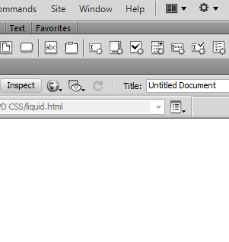
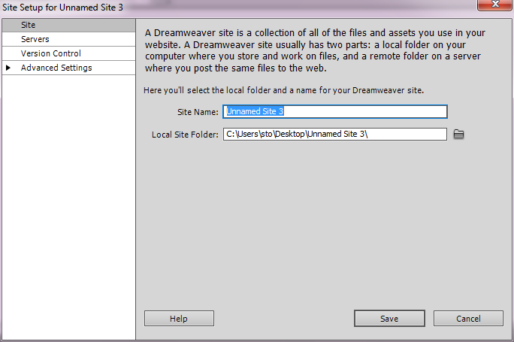
Let’s start building
Open Dreamweaver
Site > New Site …
Navigate to Local Site Folder announced
Select PixelEd PD CSS folder
Save

Slide 35
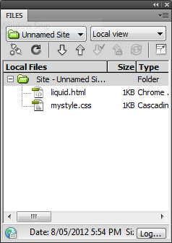
Let’s start building:
Select Window > Files
D/click these files to open :
liquid.html
mystyle.css

Slide 36
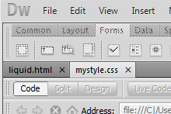
Let’s start building:
Both files can now be accessed
at the top left
Both files will be mostly empty, but we will change that!

Slide 37
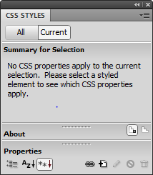
Link the files
mystyle.css is an External Style Sheet
We need to link it to liquid.html
Make sure liquid.html is the visible file, and in Code View
Select Window > CSS Styles
Click the little chain link
Browse and select mystyle.css
Click OK and OK again
Check the HTML code for the link if you wish

Slide 38
Style the <body> tag
The <body> tag represents the whole screen
It is the background to your webpage
Go to CSS styles again
Click the + icon

Slide 39
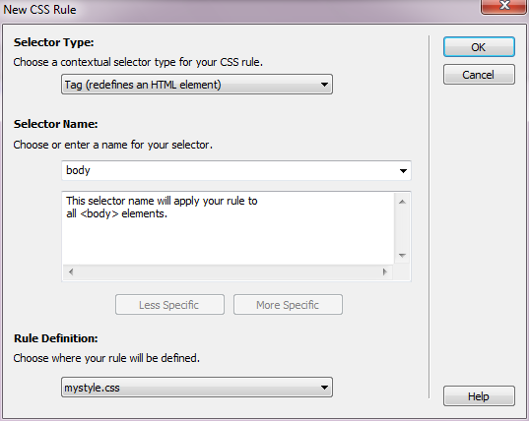
Style the <body> tag
Choose Tag for selector type
Type or select ‘body’ for selector name
Click OK

Slide 40
Style the <body> tag
Choose Background from the Dialogue that appears
Enter these styles (or just copy into mystyle.css as it appears here – easier)
body {
background-color: #ffffff;
background-image: url(images/gradient.png);
background-repeat: repeat-x;
background-attachment: scroll;
background-position: 0px 0px;
}

Slide 41
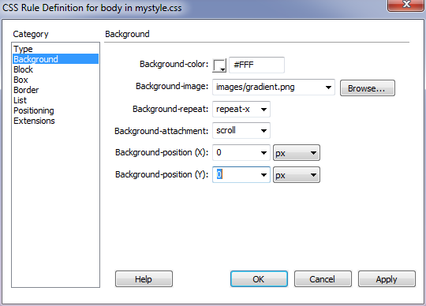
Style the <body> tag
You should have this if you have used the dialogue box. Press OK.

Slide 42
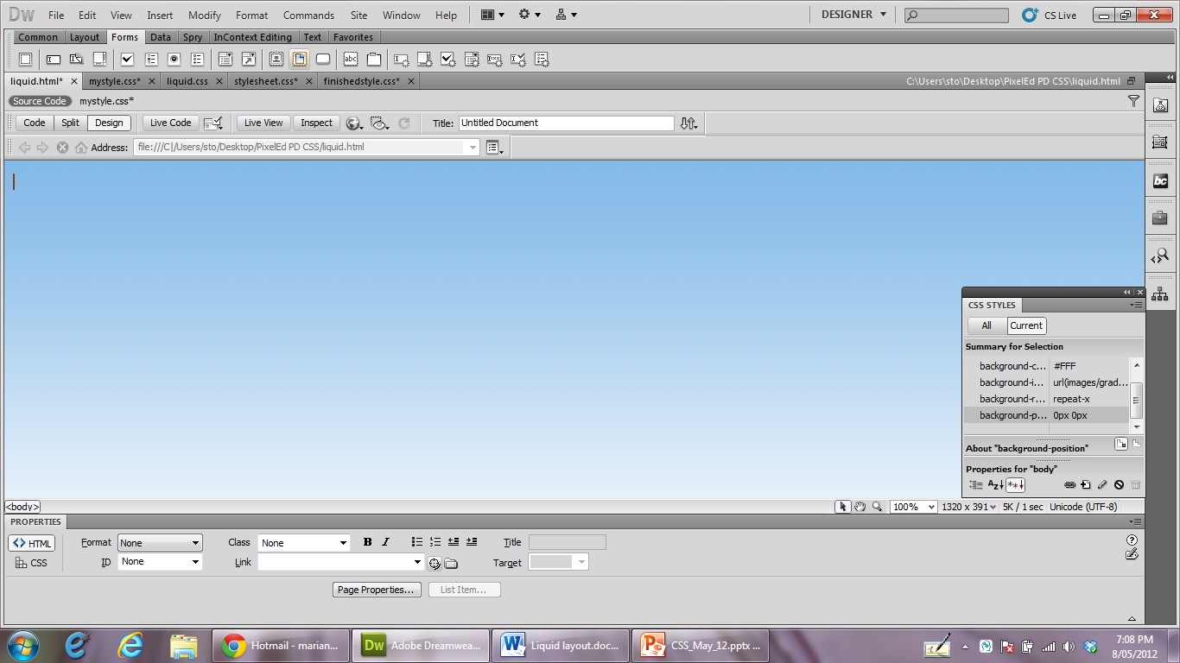
Style the <body> tag
Save your mystyle.css
Open your liquid.html in Design View
You should see this background:

Slide 43
The DIVs
Adding and styling them

Slide 44
Create a #container ID
Type the following into mystyle.css
#container {
width: 800px;
height:700px;
margin:0px auto 0px auto;
/*auto left and right centres the div*/
background-color: #cfc;
}

Slide 45
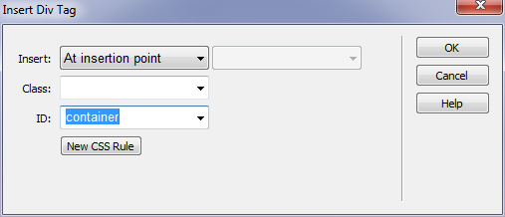
Create a #container ID
Go to liquid.html in Design View
Insert > Layout Objects > Div tag
Choose ‘container’ for the ID
Click OK

Slide 46
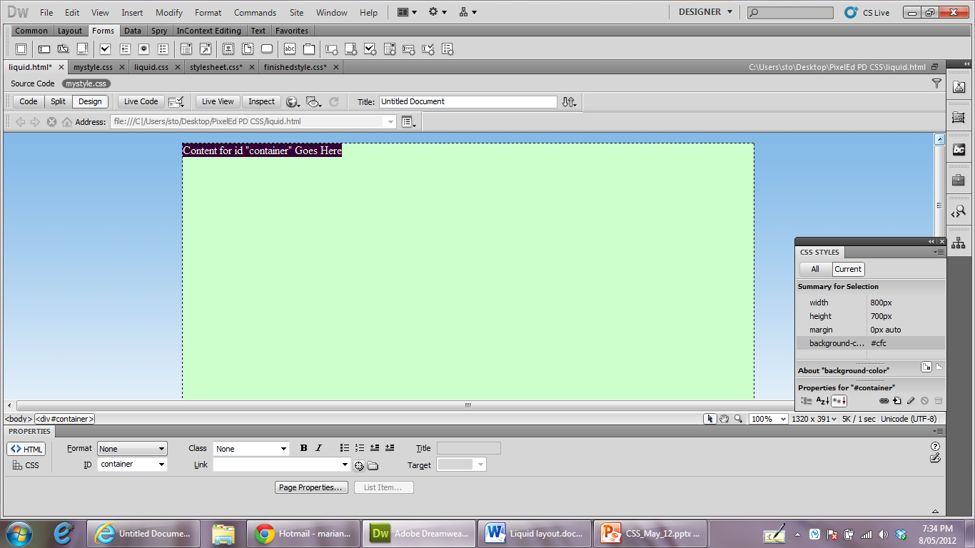
Create a #container ID
This container div will contain all the others:

Slide 47
Create the #banner div
Now create the #banner ID. Type the following into mystyle.css then save:
#banner{
/*banner.jpg measures 750 by 100*/
width: 750px;
height:100px;
margin:10px auto 10px auto;
/*auto left and right centres the banner div in the container*/
background-color: #ccc;
}

Slide 48
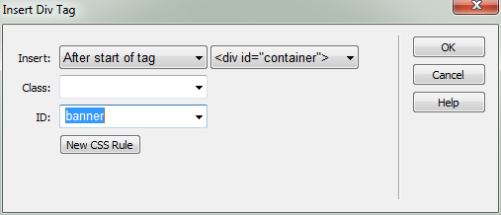
Create the #banner div
Insert a new div as below
This time the ID is ‘banner’

Slide 49
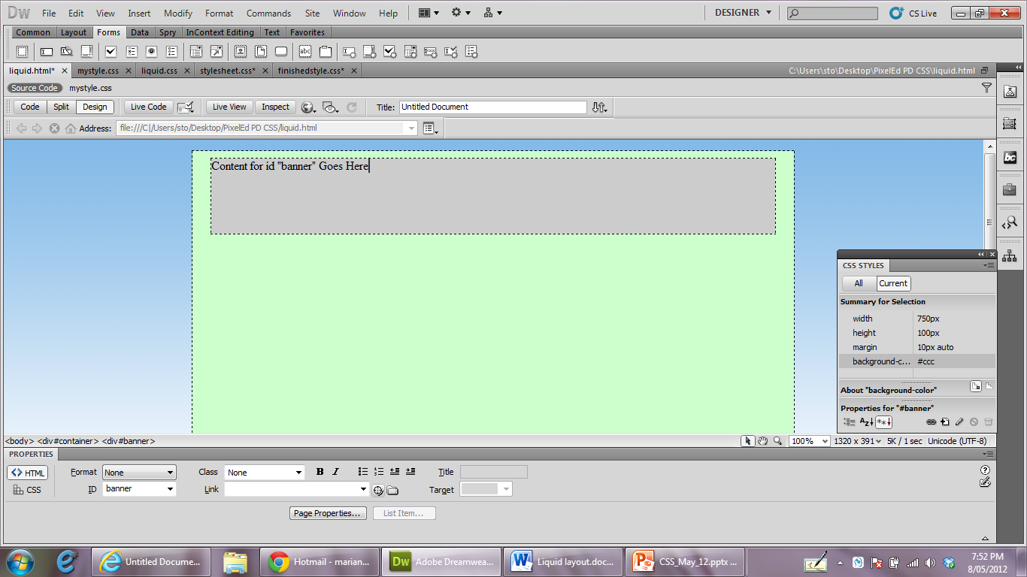
Create the #banner div
The banner div should appear inside the container

Slide 50
Create the menu div
Now create the #menu ID in mystyle.css:
#menu{
width:20%;
height:500px;
background-color: #345ccc;
margin:10px 1% 20px 2%;
/*float left sends the menu to the left*/
float:left;
}

Slide 51
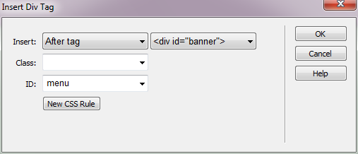
Create the menu div
Create the menu div with these settings:

Slide 52
Now for the columns
Create the #col1 ID in mystyle.css
#col1{
width:25%;
margin:10px 1% 20px 1%;
height:500px;
background-color:#0C3;
float:left;
}

Slide 53
Now for the columns
Now create the #col2 ID in mystyle.css
#col2{
width:25%;
margin:10px 1% 20px 1%;
height:500px;
background-color:#9F3;
float:left;
}

Slide 54
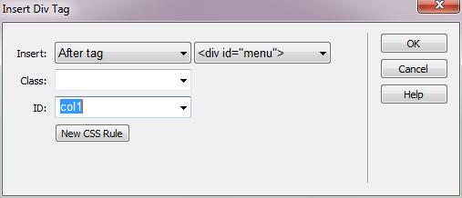
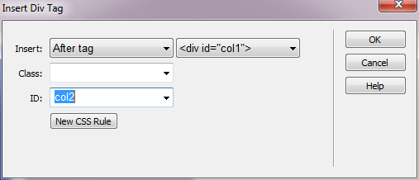
Now for the columns
Create col1 div
Create col2 div

Slide 55
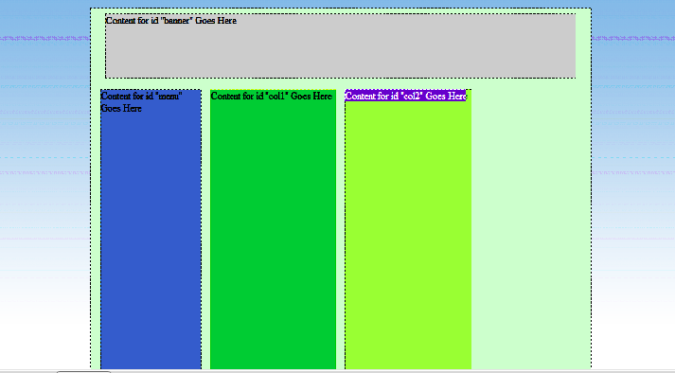
Now for the columns
Your webpage now looks something like this:

Slide 56
Add the Ads div
Create the #ad ID in mystyle.css:
#ad{
width:20%;
height:500px;
margin:10px 2% 20px 1%;
background-color:#C06;
float:right;
}
Note that the ad div floats RIGHT

Slide 57
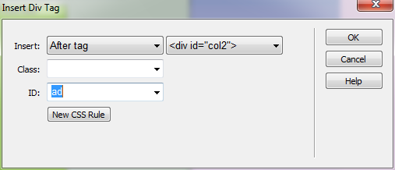
Add the Ads div
Add the ad div as below:

Slide 58
Add the footer and finish!
Create the #footer ID
#footer{
width:100%;
margin:0px auto 0px auto;
height:40px;
background-color: #ff3;
/*clear:both puts the div on a new line */
clear:both;}

Slide 59
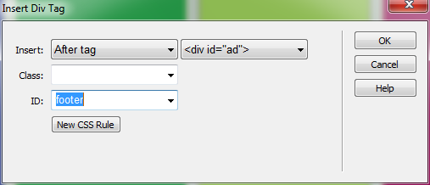
Add the footer and finish!
Now add the footer div

Slide 60
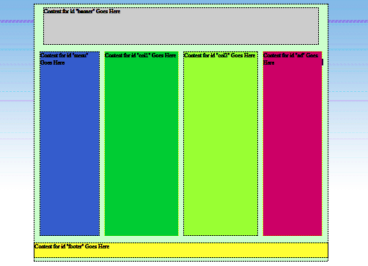
Add the footer and finish!
You should have this:
Press F12 to preview your page in a browser

Slide 61
Make it liquid now

Slide 62
Make it liquid
A Liquid Layout expands and shrinks depending on the size of the window.
Change your #container ID a little to get this
#container {
/* these next two lines make it liquid*/
min-width: 800px;
max-width: 1000px;
height:700px;
margin:0px auto 0px auto;
background-color: #cfc;
}

Slide 63
Make it liquid
Preview your page in the browser (F12)
Set the browser window on ‘Restore’
Drag the window narrower and wider
Your webpage content should shrink and grow in width

Slide 64
Add content

Slide 65
Add a banner
Drag the image banner.jpg from the images folder to the banner div
It should fit exactly

Slide 66
Add headings and paragraphs
Create styles for <h1>, <h2> and <p>:
h1 {
font-family: Times New Roman, Times, serif;
font-size: 48px;
color: #695A49;
text-align: center;
vertical-align: top;
padding:5px 5px 5px 5px;
}

Slide 67
Add headings and paragraphs
Create styles for <h1>, <h2> and <p>
h2 {
font-family: Arial, Helvetica, sans-serif;
font-size: 21px;
color: #FFFFFF;
text-align: left;
text-transform: capitalize;
padding:5px 5px 5px 5px;
}

Slide 68
Add headings and paragraphs
Create styles for <h1>, <h2> and <p>
p {
font-family: Arial, Helvetica, sans-serif;
font-size: 14px;
font-style: normal;
color: #6F5742;
padding:5px 5px 5px 5px;
text-align: left;
margin-left: 30px;
}

Slide 69
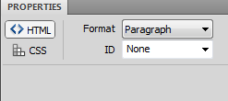
Add headings and paragraphs
Type in some headings and some paragraph text into col1 and col2. Use the Ipsum Lorem file provided if you wish
Use Window>Properties>Format to give your text the appropriate content tags: Paragraph, Heading 1 or Heading 2

Slide 70
Add a centred image
Create a CLASS in mystyle.css to centre an image:
.centre{display:block;
margin:5px auto 5px auto;}
Drag MoMA.jpg into the ads div
In Windows>Properties>Class, choose ‘centre’

Slide 71
Add some menu items
Type in a couple of menu items, eg:
About Us
Contacts
Link them to page2.html and page3.html

Slide 72
Add some menu items
Now style the links in mystyle.css.
Firstly the basic link:
a:link {
font-family: Arial, Helvetica, sans-serif;
font-size: 16px;
color:#663;
text-align: center;
}

Slide 73
Add some menu items
Now style the hovered-over links a slightly different color:
a:hover {
font-family: Arial, Helvetica, sans-serif;
font-size: 16px;
color: #633;
text-align: center;
}

Slide 74
Add some menu items
Lastly style the visited links a darker color:
a:visited {
font-family: Arial, Helvetica, sans-serif;
font-size: 16px;
color: #603;
text-align: center;
}
Preview in Browser (F12)and test the links

Slide 75
Resources
http://www.w3schools.com/css/css_intro.asp
SAMS Teach Yourself CSS in 10 minutes by Russ Weakley
http://www.softpedia.com/get/Internet/WEB-Design/HTML-Editors/TopStyle-Lite.shtml
Notes:
The World Wide Web Consortium (W3C) is an international community that develops standards to ensure the long-term growth of the Web. W3schools is an area of the website that contains tutorials on almost everything web: CSS, HTML, XML...
I use the SAMS Teach Yourself CSS in 10 minutes on a regular basis. I find it clear and easy to read with a good range of exmples.
Top Style Lite is the program I use to write Style Sheets. I find it invaluable, in the beginning it saved me from remembering all of the different properties.

Slide 76
Bibliography
http://janhallfors.blogspot.com.au/
http://www.w3schools.com/css/css_intro.asp
http://www.w3.org/TR/CSS2/images/longdesc/boxdim-desc.html

