Slide 1
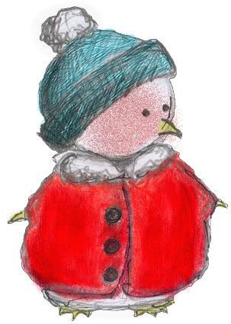
Certificate 3 in VET Interactive Digital Media
Year 1 - Units 1&2
Beginner’s Guide
Claire Bloom
Warrandyte HS
claire@warrandytehigh.vic.edu.au
Ana Tuckerman,
www.anatuck.com
anatuck@gmail.com

Slide 2
The Course

Slide 4
Which Elective Units?

Slide 5
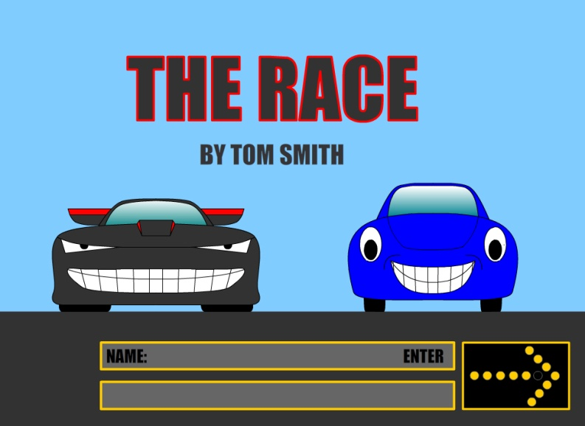
What’s in a Unit of Competency?
Unit title and code
Unit descriptor
Employability skills
Pre-requisite or co-requisite units
Application of the unit
Competency field
Unit sector
*Elements of competency
*Performance criteria
*Required skills and knowledge
*Range statement
*Evidence guide
www.training.gov.au

Slide 6
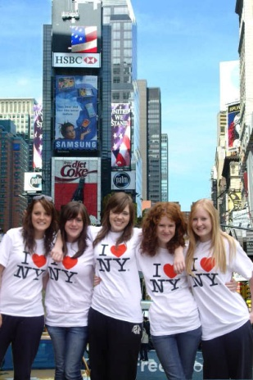
Software?
Train students in the software they will use in the Year 12 online exam – Industry Standard
http://www.vcaa.vic.edu.au/Documents/exams/vetidm/2013/2013IDM_Software.pdf

Slide 7
How much depth?
CUFDIG303A - Produce and prepare photo images
ELEMENT
RANGE STATEMENT
Use scanner to capture photo images.
Use digital camera to create photo images.
Edit photo images.
Prepare photo image assets.
Unit of Competency Range Statement says:
Manipulating digital images may include:
• appending text/type for files and captions
• brushing
• creating artistic effects
• cropping
• editing
• eliminating red eye
• emulating photographic effects
• image enhancement including tones, contrast, colour cast/tint, saturation
• masking layers
• retouching (i.e. cloning, rubber stamping, healing,
patching)
• sharpening
• stitching (panoramic scenes)
• using layers for composites
• using pre-sets.
PERFORMANCE CRITERIA
3.1 Load digital imaging software and import photo image source files.
3.2 Manipulate and save digital images using designated digital imaging software.
3.3 Create photo images that incorporate visual design and communication principles using designated digital
imaging software.
3.4 Evaluate the outcome for visual impact, effectiveness and
fitness for purpose.
3.5 Confirm outcome with relevant personnel.

Slide 8
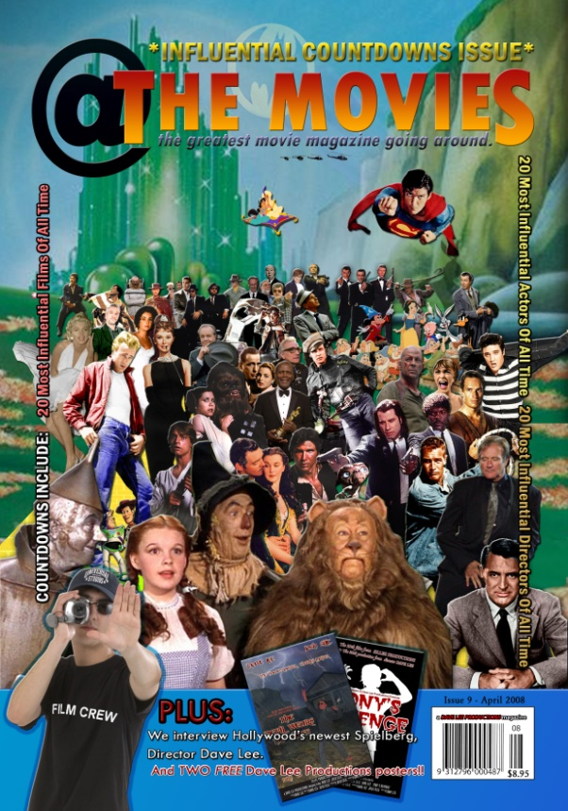
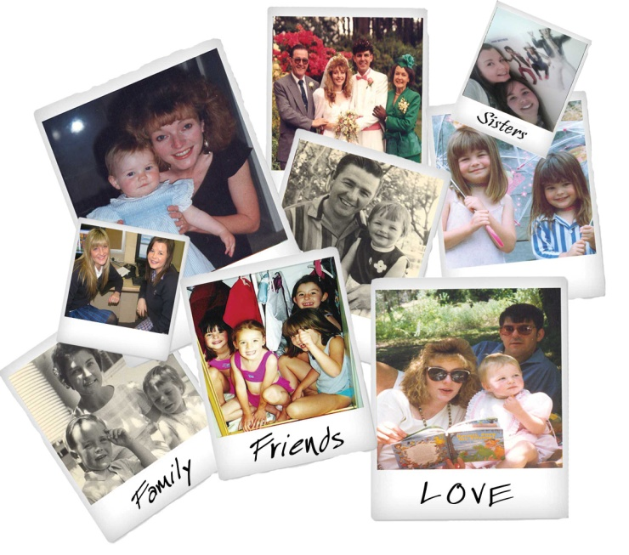
Resources – there’s no text book!!
Mailing List - http://www.edulists.com.au
http://www.pixeled.org.au
Youbee (was Natcoll) Publications
http://www.vcaa.vic.edu.au
http://www.adobe.com/education/k12/

Slide 9
Examples of tasks and unit combinations
Ana
CUFDIG303A - Produce and prepare photo images with CUFDIG201A - Maintain interactive content.
Tasks
Road trip – Photography
Mythical Me – Image manipulation
Web site – Maintain interactive content

Slide 10
TASK 1 Road trip
Use digital camera to create photo images.
2.1 Discuss photographic project brief with relevant personnel.
2.2 Assess digital camera features to ensure that outcomes
will meet the requirements of brief.
2.3 Plan camera shots taking into account lighting, framing,
composition and other photographic techniques .
2.4 Load and operate digital camera according to
manufacturer specifications.
2.5 Consider digital camera focus, exposure and shutter
speed to ensure image capture meets production
requirements.
2.6 Check photographic images for fitness of purpose to
comply with brief.
2.7 Transfer and store photographic image files to a computer
using standard naming conventions.

Slide 11
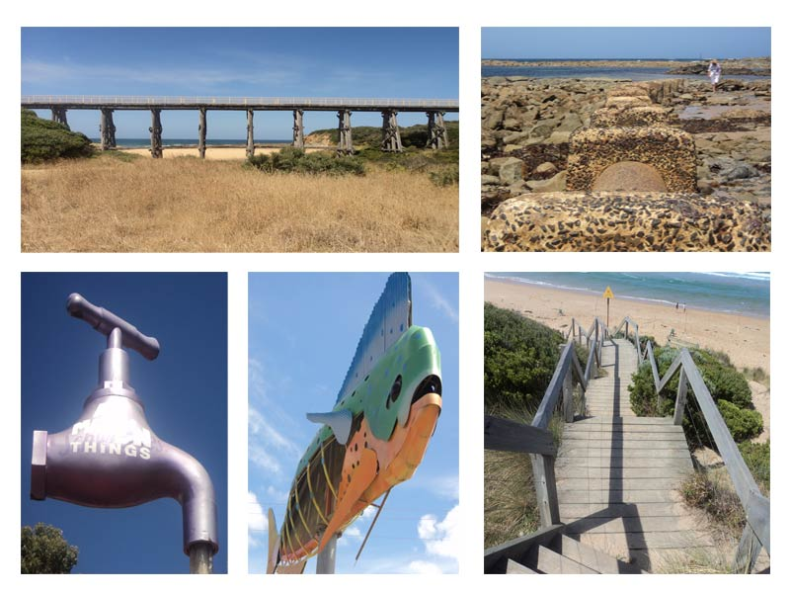
TASK 1 Road trip

Slide 12
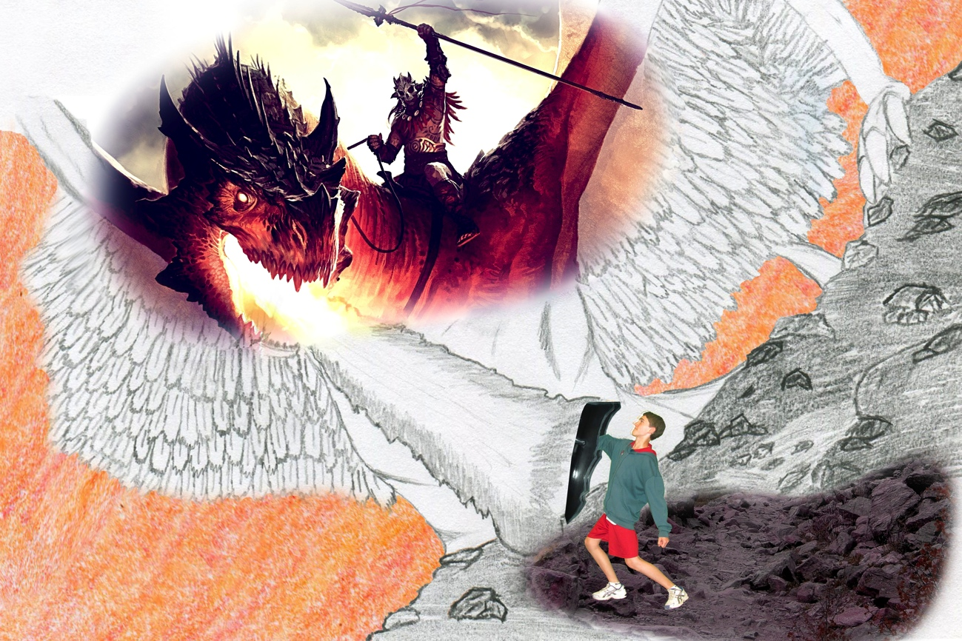
TASK 2 Mythical Me
Use scanner to capture
1.1 Source and select appropriate photographic images according to requirements of photographic project brief.
1.2 Discuss selection of images with relevant personnel .
1.3 Assess scanner features to ensure that outcomes will meet the requirements of brief.
1.4 Operate scanner according to manufacturer specifications.
1.5 Select scanner settings to ensure image capture meets production requirements.
1.6 Transfer and store photographic image files to a computer
using standard naming conventions.

Slide 13
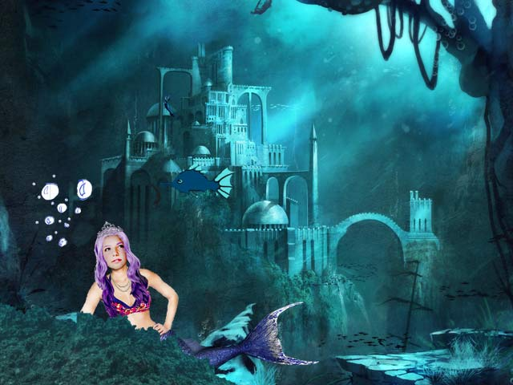
TASK 2 Mythical Me
Edit photo images.
3.1 Load digital imaging software and import photo image source files.
3.2 Manipulate and save digital images using designated
digital imaging software.
3.3 Create photo images that incorporate visual design and
communication principles using designated digital
imaging software.
3.4 Evaluate the outcome for visual impact, effectiveness and
fitness for purpose.
3.5 Confirm outcome with relevant personnel.

Slide 14
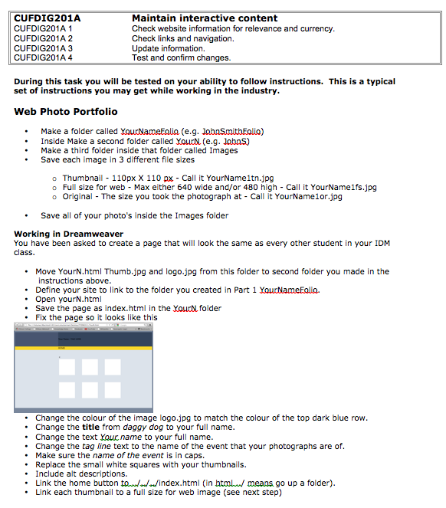
TASK 3 Website

Slide 15
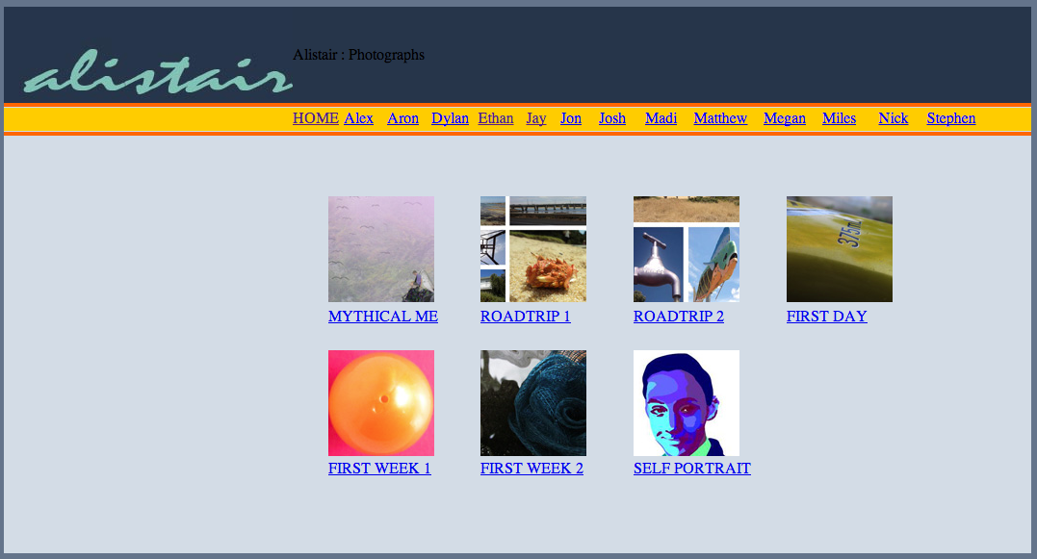
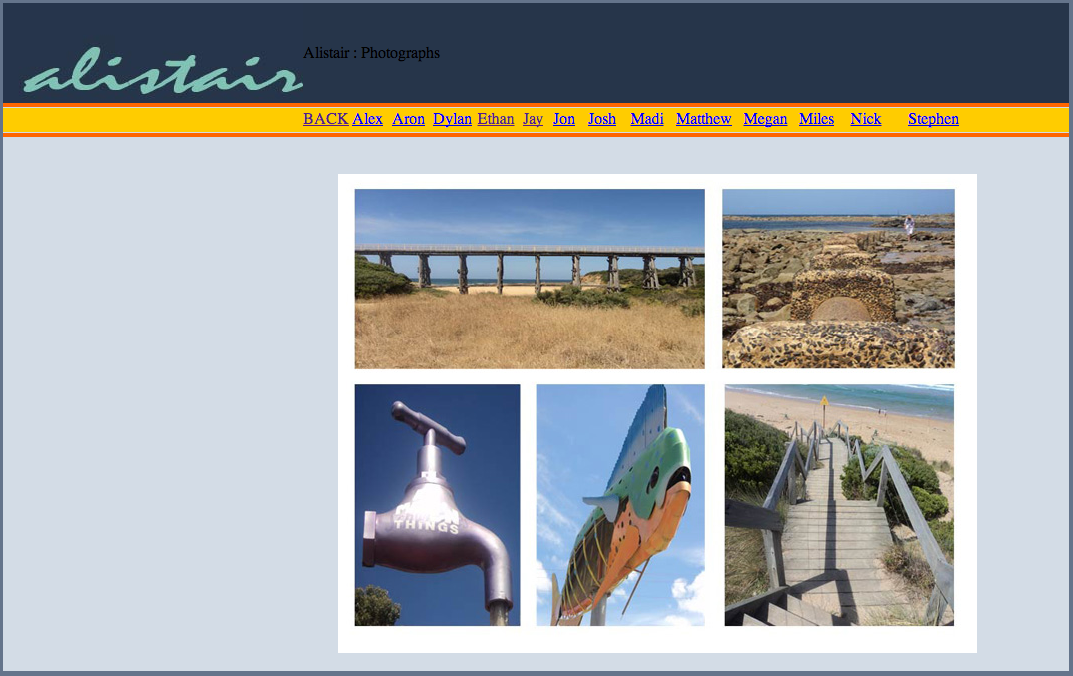
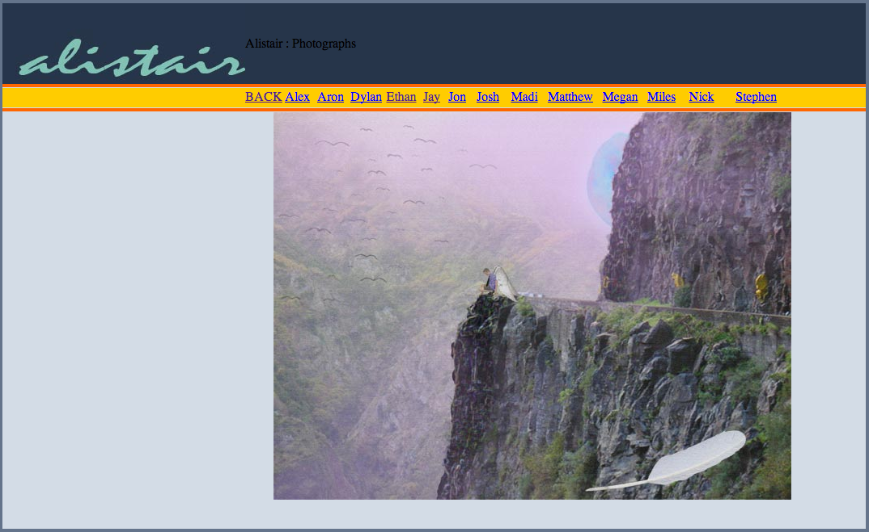
TASK 3 Website

Slide 16
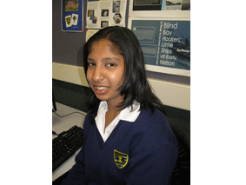
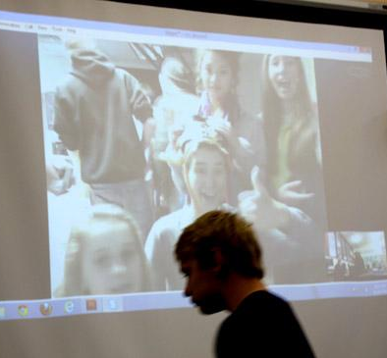
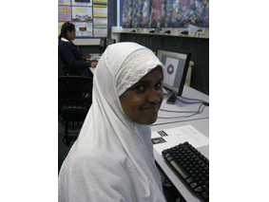
A few of Claire’s ideas:
Design the cover for the school planner
About Me - Scan objects, manipulate images
Travel promotion – travel poster, postcards, logo
Collaborative global project - web creation
Copyright test
Audio manipulation exercises
Children’s Book Cover
OHS Animation
T-shirt design and print

